Slide 1
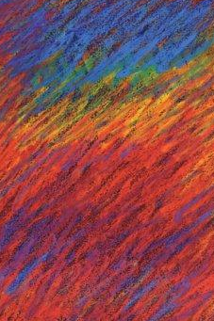
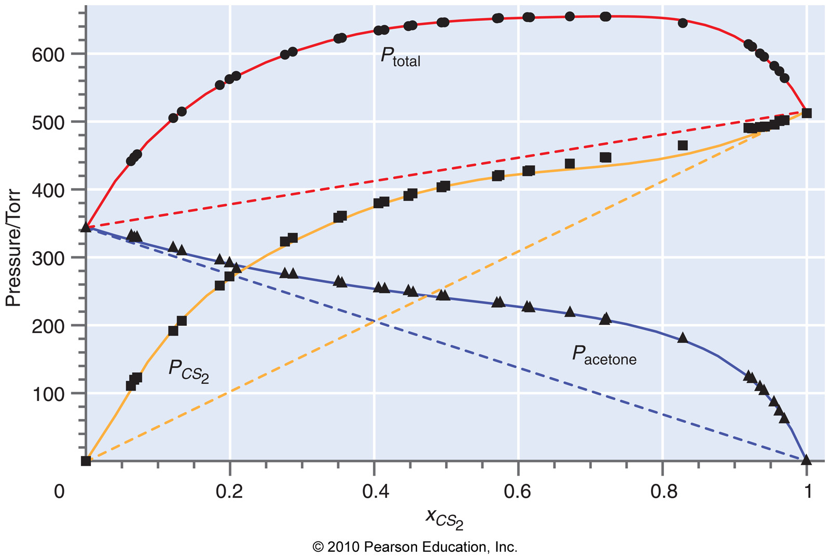
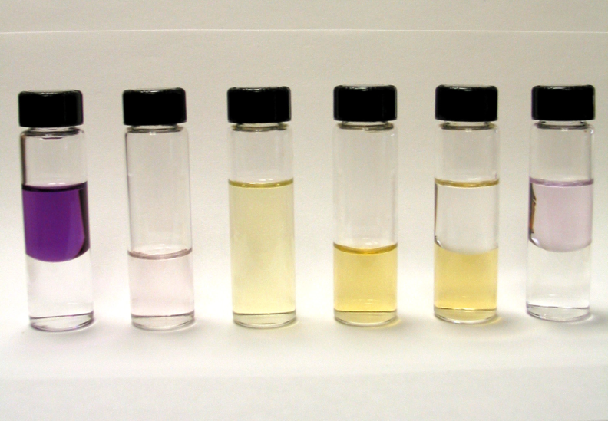
CHEM 450/450G
Dr. M. J. Nee
Lecture II-7
Activity and Real Solutions
Plan for Today:
Partial molar quantities
Real Solutions and activity
Limiting Laws: molecular perspective
Partially miscible liquids

Slide 2
Real Solutions deviate from Raoult’s Law
Consider the acetone-CS₂ system:

Slide 3
Partial molar quantities
Chemical potential is
There are other partial molar quantities for the other state functions, such as partial molar volume:
So that the total volume,
It is no longer valid to assume that V = V₁+V₂!!

Slide 4
Ideal dilute solutions and activities
Activity (a) is for solutions what fugacity is for gases: effective concentration (e.g., for use in Raoult’s Law):
Activity coefficient (γ) is for solutions what fugacity coefficient is for gases:

Slide 5
Chemical potential and activity
When we have a non-ideal solution, we can re-express the chemical potential of each component with the activity, instead of the mole fraction:
What are the implications of this statement?

Slide 6
A molecular perspective
= A
= B
Forces are mostly B-B
Raoult’s Law
Forces are mostly A-B
Henry’s Law
Forces are mixed: A-B and A-A
Real Solution: use activities!

Slide 7
Activities defined by standard states
For the solvent, use the Raoult’s law standard as above:
For the solute, use the Henry’s law standard as above:

Slide 8
Henry’s law and gas solubility
So why does warm Coke go flat?

Slide 9
Calculating Activity from data
We can calculate the activity of each component in a mixture based on the compositions in the vapor (y_{i}) and in the solution (x_{i}):

Slide 10
Using activity
Activity is an effective concentration.
Any time you would use concentration (like in Raoult’s law) for an ideal solution, you should instead use activity for a real solution.
As an example, to calculate the vapor pressure of a solution with γ₁ at different concentrations (in mole fraction, x₁), use Raoult’s Law

Slide 11
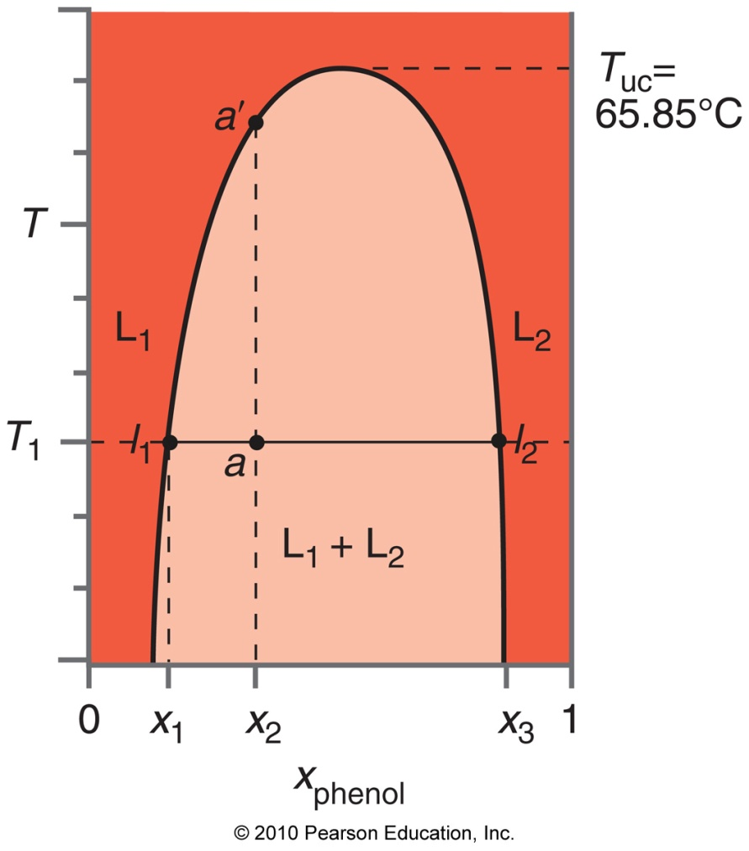
Partially miscible liquids
We will deal qualitatively with the phase behavior of partially miscible liquids. Most have an upper consulate temperature, above which the liquids are fully soluble at any composition.
Below the UCT, only a certain amount is soluble.
This is water-phenol.

Slide 12
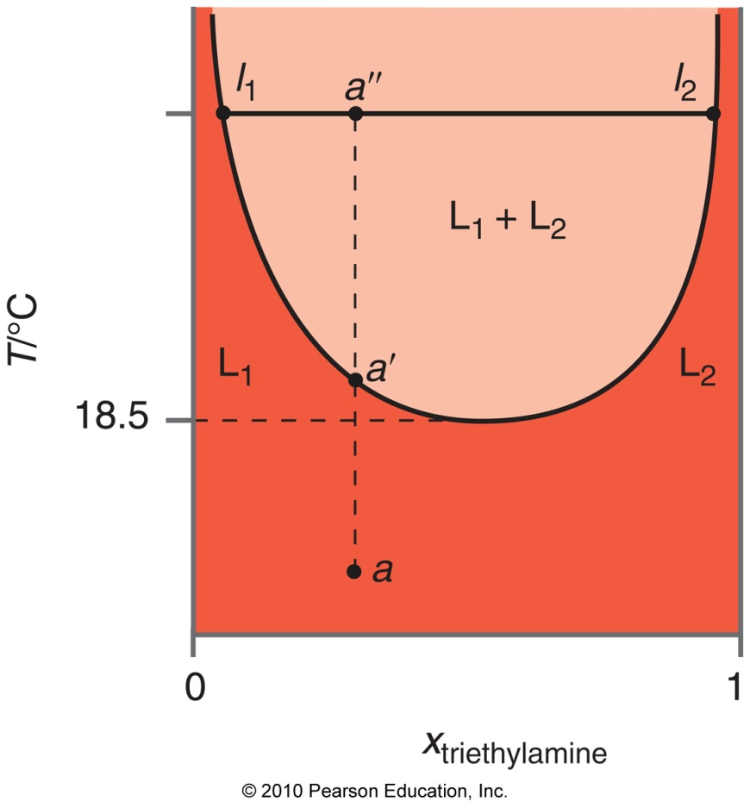
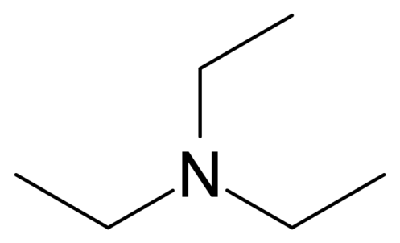
Lower consulate temperature
Why might triethylamine-water have a lower consulate temperature? Consider the Gibbs Energy of mixing, and the entropic and enthalpic contributions.

Slide 13
Chemical Equilibrium: A Review
For Gases:

Slide 14
Equilibrium in solution
Now, we must reference ourselves to a standard concentration: c° = 1m.
We also need to account for the activity of the solution, instead of using the straight concentration.
For an ideal solution, molarity or molality is fine instead of activity. Remember, the standard concentration is used for solids, so that they do not influence eqm.

Slide 15
For next time: Read Chapter 10. Our last Unit II lecture will cover that material. You may have seen some before, but it will get more involved. This stuff (and what is covered today) will be on HW 7, due 10/29.

